Slide 1
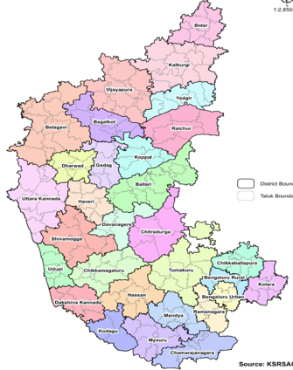
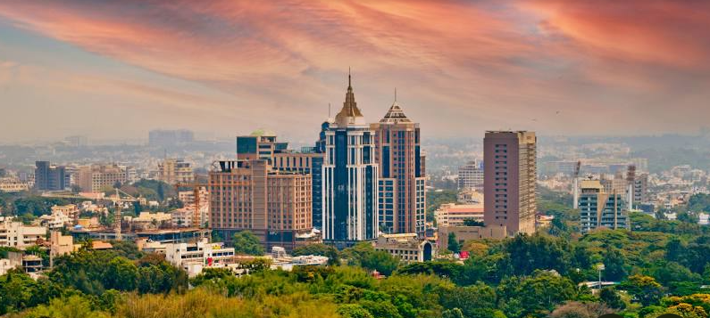
Hello Visitors to Bengaluru, are you aware of kannada language !!
Here are the pocket tips for quick Learning
A crash course pages for new arrivals in Karnataka
By
Dr.Gurudutta Gangenahalli,
FNABS, FICI, FRSM, FRSB, FRACI CC, FRSC.
Recently, Karnataka state has imposed a strict compliance rule to speak Kannada language which is a native state language (also, it is one of the national languages) by non-Kannada speaking travelers/visitors/residents at basic levels, aiming to protect the heritage status of the state culture and language, and also to ensure easy communication with native people.
I am a very fluent “native Kannadiga” from Bengaluru”, but live and speak “native Hindi” language as I stay in Delhi now over 40 years.
I also lived in non-English Brazil (other than USA etc.) where I could learn elementary level “Portuguese” language and I could successfully manage to live with Brazilian people and travel all over the Brazil, and also, study at University of Sao Paulo, Brazil.
Therefore, I decided to help non-Kannada speaking travelers or visitors in India, who travel to Karnataka and to Bengaluru. I have designed the following written crash course template to learn by “by-heart” or “by repeated readings” for long-term remembering, enabling to converse in “Kannada language” with local people in the beginning stages of their life.
The Kannada is a sweetest and oldest language originated from Sanskrit. It is a poetic language. Hence, it has made many non-Kannadiga’s as great poets, musicians and celebrity actors of this country. I hint, poetic Kannada language bears many, many words similar to Hindi, accept little difference in their pronunciations. You will realize it gradually, eventually becomes easiest language. Please take interest. Keep enjoying it.
For free updates & for online pronunciation classes subscribe my channel www.nirdhaarit.com
Silicon valley of india
Tech capital of india
Sl. No | English word | Kannada verbatim | Context to use
1 | my or mine | nanna or nanna-dhu | to say some thing that is asked or to say “mine”
2 | yours | ninna (singular), nimma (plueral with respect) | to ask a person standing in front of you some thing of him
3 | name | ahesaru (meaning “name”) | to ask or to tell my “name” ?
4 | place / town | jaga or pattanha or huuru | when you are going to ask another person or you are being asked
5 | to greet (first use just like in Hindi) | namasthe or namashkara or namashkara sir or namaskhara madam (if encounter decent girl / a lady) | (you can start talking at any time by telling this to any one, probably you meet for the first time in the day) to any body…….

Slide 2
Instagram ppts

Slide 3
6 | to greet a known person | namasthe or namashkara (when group is large add “snehithare”), (for father, sister, any elderly person etc. no need tell their identity by name. Only namasthe or namashkara is enough) | use anyone word
7 | greet first (namasthe or Hello or Hello Sir) I am From Delhi or Patna or Lucknow | namasthe or namaskhara (sir or madam) ji, Nanu delhi-ya-vanu (I am of Delhi), Nanu (meaning “I am”) delhi-indha (from Delhi) bandidh-dhene (have come from) | use these words or sentences when you want to ask some one some information, you can start like this….
read continuously
read all continuously, whole thing is one sentence
read continuously
read continuously
8 | what do you want ? what do you want sir ? what do you want madam ? what do you want Mr ? | henu-beku ? henu-beku sir? henu-beku madam ? henu-beku Mr ? (henu means “what”, nimaghe means “for you”, beku means “want”) (you can add - sir or madam or Mr) if you wish depending upon to whom you are telling or asking | while some one, a Auto/Cab driver, notices you that you are looking for some thing and he or she ask you “what you want on street, in shop, in office, waiter in restaurant etc.
9 | I don’t know Kannada | nana-ghe (means “for me”) kannada (you can add this word “Bhashe/Bhasha”) (obviously i.e., kannada language) gotthi-ella (means “don’t know”) | start with this when you start asking some information from some one or when someone asks you “do you know kannada” or “speak kannada”
read continuously
Ask politely (this is a question)
(you to others or some one to you, may use only one sentence)
read all continuously, whole thing is one sentence
read continuously
read continuously

Slide 4
10 | what are you doing ? what do you do ? what job do you do? what do you do ? | yenu or henu (means “what”) neehu (means “you or you are”) madu-thi-ra (means “doing”) neehu yenu or henu madu-tthi-ra yanu or henu (means “work”) mad-utthi-ra neehu yenu or henu madu-tthi-ra ? (obviously refers to work or profession) | depends on circumstances – asking a profession, job or casually asking what are doing ? asking a question like asking your future plan after some thing happened or you lost some thing. So, what next ?
11 | I know little, little Kannada I speak little Kannada | nanu (means “I” or “myself”) swalpa (means “little”), swalpa (“little”) Kannada (obiviously indicate Kannada language) gotthu (means ‘know”) Nanu (means “myself”) swalpa (means ‘little”), swalpa (“little”) Kannada (obviously indicates Kannada language) mathan-nadu-the-ne (means “can speak”) OR matha-nada-balle (means “able to speak” | if you want to make clear in the first instance clear to another person (may be to a person standing in front of you or who have asked you a question) that you don’t know Kannada very much. because you have used “swalpa” meaning little “you can”
12 | I need some or one help | nanaghe ondhu (meaning “for me one”) sahha-ya (means “help”) (can also say this in english word “help”) beku (means “want” or “need”). | after the above, you can request one help
Read continuously & two sentences are separate), (but, you can also tell two sentences at the same time
read continuously fast
But two sentences are separate
Notes:
"

Slide 5
13 | know ? do you know ? | gotthha ? Ni-ma-ghe ( means “for you”) gotta (means “you know” or “do you aware”) ? | like this “do you know” any one can ask this referring to anything, any item including Kannada language
14 | don’t know I don’t know | go-tthhi-illa = go-tthhi-illa nana-ghe (means “for me”) go-thhi-illa (means “don’t know”) | -you can reply like this
15 | yes, I “know” | go-tthu (or, nana-ge go-tthu) (= know or I know) | yes “I know”
16 | do you know? are you aware ? here, do you know where is X (restaurant or theatre or building?) | ni-maghe (means “for you”or ninaghe (means “singular for you“) go-tthha ?(means “you know” ?) elli (means “here”) nimaghe (“for you”) gotthha (“know” ?, post-fixed to -X (restaurant), -X (theatre), -X (Office) yelli-e-dhe (“where is present”). | when you want to ask location or existence of a place or some item ? OR somebody may ask you as they are strangers.
17 | what is your name ? | ni-mma (means “yours”) hesaru (means “name”) yenu / henu (means “what?”) | any body can ask your name
18 | how much ? how much is that ? how must is this ? how much money ? | ye-shtu ? ye-shtu (means “how much”) aah-dhu?(aadhu “means “that is”) ye-shtu iidhu (means “this is”)? ye-shtu dhuddu or hhana (means “money”?) ye-shtu bele (means “price”?) | when you are asking rate price age fare quantity etc. bele = price / cost
19 | to or to where | elli-ghe ? | Some auto driver or bus driver or friend or stranger can ask you
20 | To where do you want to go | nivu (means “you”) elli-ghe (duddu means “to where”) hoga-beku (means “want to go”)
read all continuously
read continuously fast
read continuously fast
read continuously fast
read continuously fast

Slide 6
Additional pages

Slide 7
21 | to majestic (a bus-stop in Bengaluru) (place name asking auto drive or any body to go) (add your place name) | majestic-ghe | then you can add “how much money” = yeshtu duddu (or you can also use the word “yeshtu fare”)
22 | to where | elli-ghe | you can ask to some one when that person asks you To accompany you To come (you don’t know where your friend is calling you to accompany him or her) Auto driver asks you when you ask driver “auto is free or “is this auto is free” (this word can be used to any one or any one to you depending on context including auto-driver when he see’s you).
23 | want to go I want to go | hoga-beku nana-ghe-hoga-eku nana-ghe meaning “me or for me”
24 | distance or how far from here | esh-tu (means “how much”) dhu-ra (means “far”) Illi-inda (means “from here”) | you can ask taxi or cab driver or friend to know distance to that place (a place of your interest)
25 | new city, language, for me | hosa (means “new”) city, bhasha or bhashe nana-ghe (for me) | ---
read continuously
read continuously
read continuously
(hoga means “to go”, beku means “want to “
read continuously
Combine and read continuously

Slide 8
26 | do “you” know | nina-ghe (singular) or nima-ghe (pleural) gottha ? (meanings of both words have already explained previously) | when you are asking some one an address/road/some thing about OR some one can also ask you like this
27 | please can you tell me address of this road or building or address | please, nihu (means “you”) vilha-sa (means “address”) yelhuthira (means “can tell”) nana-ghe (means “to me”) Caution: pronounce “lhu” press-hard. Simple elu-thira is very bad word (DON’T USE THIS WORD) | you can use some common English words in between in many places (of building or road or office or shop etc. – you can use directly these English words)
28 | road | rasthe or bidhi or road or dhari | while asking for a road you can use the word “Road” English word as everyone understand them
 | this road | ee road OR ee bidhi OR ee dhari
 | where is this road? | ee (means “this”) road OR ee bidhi OR ee dhari OR address ellidhe (elli-dhe means “where is?”)
29 | address | address or vilha-sa | while asking an address
30 | office | office or kacheri | while asking for office
31 | shop | shop or angadi | while asking for shop
32 | coffee shop / tea shop / restaurant / college / building | coffee shop or tea shop | while asking for coffee / tea / restaurant / college / building. You can also use English words
33 | did you finish lunch? | oota OR huta (meaning both “lunch or dinner”) aahi-tha (meaning “finished?”) | You can answer telling using – “aaudhu (meaning “yes”) mugithu (meaning “completed”). You can use “yes” also
34 | do you like? ddid you like that ? | nima-ghe (meaning “for you”) istana (like ?) (next add name of “film”, “city”, “shop”, “item” etc. nima-ghe (for you or you) ista-vahi-the (liked it) * *at the end you can add “sir”, “madam”, “friend”, “specific name of person” | In a questioning tone / manner, you can question or ask politely
Combine and read continuously
read continuously

Slide 9
35 | If you ask some one like this, they may reply like this or when some one asks you, you reply like this | good, good (twice) hau-dhu (meaning yes) for “no” (say “illa, illa”)= no, no this may apply for asking “did you like” for any other thing. Answer is similar “yes, yes” or “no, no” |  | all these can be used while you are asking or telling to any other person standing in front of you and conversing with you. you can also use English words in middle, because, every one understands English words in Karanataka. also, use of words depends on the context as in case of “Hindi”
36 | food did you had your food? food is over ? (while asking in canteen or mess to some one or your freind | oota or huta (common to dinner or lunch) oota or huta ha-yyee-tha * (meaning you are asking to some one had your food ?) *at the end you can add “sir”, “madam”, “friend”, “specific name of person”
37 | they may reply or you can reply if some one asks you. | yes or hau-dhu (hau-dhu means “yes” no (illa means “no”) | normally people in office use English words “yes or no”
38 | big city Caution: don’t misspell dhodda as “dhoddi”, it is a very bad or dirty word. very good city interesting city | dho-dda city (dho-dda means “big”) you can use this “dhodda” word to any thing that is big. you can add prefix or post fix items like these name (city, car, tree, land area, bag etc.). Just like in Hindi. thumba valle-city (thumba means “very much”) you can also use this word for any other thing. Valle (good, very good or good) interesting or fun is “thamashhe” or “valle” city. You can also use word “entertainment” city

Slide 10
39 | looks good looking good | channa-ghi-idhe (means “good”, “looking good”) you can even prefix the word “thumba” or “bhahala” (means “very much”). For example: tumbha channa-ghi-idhe Car tumba channa-ghi-idhe restaurant tumba channa-ghi-idhe city tumba-chnna-ghi-idhe food etc. you can also prefix the word “bha-hala” meaning is the same | If some one asks you a question ? you can prefix or post fix (add to sentence) what was asked about. add it at the end of the word “channa-ghi-idhe city”. City is added here at the end. ‘channa-ghi-idhe car” city restaurant car building Food (dinner, breakfast, lunch, or any single item by name etc. Like in Hindi: accha hai – car achha hai – city achha hai – building etc.
40 | not all right not every thing all right little not alright | sariya-ghi-illa (means “not alright” or “not up to mark”) ehlla or ahella (means “all” or “every thing”) + sari-haghi-ehlla or illa (means “not alright or not good”) swalpa sari-yaghi-illa (swalpa means “little”) | understand continuity and reply and express
41 | from where where are you coming from? | elli-inda or ehlli-indha (means “from where”) nivu or nihu (means “you”) elli-indha or ehlli-indha (means “from where”) baru-thidhi-ri (means “coming”) | to answer, if some one is asking you “where are you from” or “from where are you coming from”
read continuously
read all continuously
You can post fix tumba or bhahala to channa-ghi-idhe.
tumba or bhahal = bahut like in Hindi
read all lines
continuously
read continuously

Slide 11
42 | I am coming first time | nanu (means “my-self”) modala-bari or modala-bari-ghe (means “for the first-time”) baru-thidd-dhe-ne (means “coming”) | you can answer like this if some one asks you as explained in the previous page you can also use “first-time” as this is a common word
43 | I didn’t understand | nana-ghe (means “I” or “for me”) artha-vaga-lilla (means “didn’t understand”) | When some one asks you, did you understand? (thilitha?) (gotthai-itha ?)
44 | how are you ? you reply – I am good we are good | nivu or nihu (means “you”) yeghi-dhhi-ra ? (means “how you are”) channa-ghi-idhi-ni (meaning “good” (singular) nau or nahu (means we) channa-ghi-di-vi (are good) (pleural) | some one asking you and you can reply in this way?
45 | looking good | nodu-vu-dha-kke (to look) channa-ghi-idhe (good) | ------
46 | thank you | dhanya-vadha-galu you can also use “thank you” | depends upon person to whom you are telling. You can also use this English word.
Both read continuously
Both read continuously
read continuously
read continuously

Slide 12
47 | you are troubling me for me you are or it is trouble some it is difficult for me | nihu (meaning “you”) thondha-re (meaning “trouble”) kodu-bedi (don’t give me). nana-ghe (meaning “for me”) aadhu (meaning “it is”) thondha-re (meaning “difficult “) sir, madam, Mr etc. depending upon to whom you are telling | post fix “Sir”, “Madam” and “Mr” etc. depends upon to whom you are talking or addressing.
48 | why ? | ye-ke | ----
49 | very (Hindi=Jhadha) difficult very difficult very hot very far very costly very beautiful very beautiful | bha-ha-lha kashta bha-ha-lha kashta bha-ha-lha heat bha-ha-lha dhura (dhura meaning “far”) bha-ha-lha costly or bhahala dhubhari bha-ha-lha chann-ghi-dhe bha-ha-lha akar-shitha-vaghi-idhe | -you can add this word (pre-fix or post fix) along with many other words depending upon circumstances. -you can use English words like “costly”, very good, heat, difficult etc. depending upon to whom you are talking.
50 | learning to learn | kaliyu-thidh-ene kaliyu-dha-kke | -----
51 | How much ? | Yestu or eshtu ? | you can add this word (pre-fix or post fix) along with many other words depending upon circumstances
52 | I have to go I want to go | nanu hoga-bhe-ku nana-ghe-hoga-bhe-ku (meaning “hoga” is go and “beku” is want or want to. | any one can be used
All read continuously
read both continuously
read both continuously

Slide 13
53 | what ? | ehnu or enu or henu or yenu? | you can add this word (pre-fix or post fix) along with many other words depending upon circumstances
54 | what is this? | ehunu or yenu or henu (means “what”) e-dhu (means “this”) | ------
55 | where ? | ehlli or yelli ? | you can add this word (pre-fix or post fix) along with many other words depending upon circumstances
56 | to where ? | ehlli or yelli-ghe ?
57 | do you go ? do you want to go ? do you want to go to Delhi? | nivu or nihu (you) hogu-thi-ra ? nivu or nihu hogu-bekha? nivu or nihu hogu-beka Delhi ghe? | You can add another word (post-fix) the name of place ? Change the place name
58 | where do you live? where do you live here? | ehelli or yelli (where) nivu or nihu (you) vasis-thira (do live) yelli or e-hlli (where) nivu or nihu (you) vasis-thira (do live) e-lli (here) ? | you can add another word (post-fix) the name of place ? Change the place name
59 | where can I find here ? (Instead, you can ask as “where can I get here”) | ehlli or yelli (means “where”) sigu-tthhe (means “available”) e-illi (here) --- post-fix : bread, tea, hotel, bus etc. | you can add another word (post-fix) the name of place ? Change the place name
60 | I don’t know | nana-ghe (I myself or for me) gothhi-illa (don’t know) | to say no idea or don’t know. But, say politely…
read every thing continuously
read every thing continuously
both
are same
read any one individual line continuously
read every thing continuously
read every thing continuously
read every thing continuously

Slide 14
61 | what did you say ? | yenu or henu (meams “what”) yeh-lhi-diri (meaning “did you say?”) | you can ask or some one can ask you
62 | nothing ! | henu-illa (meaning “nothing”) | as above
63 | tell after words | nantha-ra (afterwards) yelhi (tell) | you can say this. Some one may also tell you
64 | sorry / excuse (me) / pardon me (you can use English “sorry” word only, everyone understands) | ksha-mi-shi | you can say this. Some one may also tell you
65 | very | thumba or bhahala | use these words in continuously along with constructed sentences. you can also use these words broken, since you are a beginner, new-comer, people will understand
 | difficult | kashta
 | eat | thinnu
 | to eat | thinnu-vadha-kke
 | guess | hu-ye
 | to guess | Hu-ye-maduva-dha-kke
 | Sit | kuthu-kolli
 | to sit | kuthu-kolluva-dha-kke
 | go | hogi
 | to go | hogu-va-dha-kke
 | walk | nede-dhu-kondu
 | to walk | nede-yu-dha-kke
 | drive | drive
 | to drive | drive-madu-va-dha-kke
 | cold or | thanna-ge or thandi
 | chilling (for weather) | chali
(stress “yehlhi”)
read all continuously
read both continuously
read all continuously
read all continuously
(stress “lli”)
read all continuously
read all continuously
read all continuously
read all continuously
read all continuously
read all continuously

Slide 15
66 | heat | bisi | use these words in continuously along with constructed sentences. you can also use these words broken, since you are a beginner, new-comer, people will understand
 | hear | khe-lu (stress “khe”)
 | sound | shab-da (you can use word “sound” also)
 | to hear | kheluvu-dha-kke (stress “kke”)
 | far | dhura (stress “dhu”)
 | too far | bhaha-la (meaning “too”) dhura (stress “bha”)
 | near | hatthi-ra
 | near to us | namma (to us) hatthi-ra (near)
 | location | jaga or sthala
 | yesterday | ni-nne
 | today | eva-tthhu
 | tomorrow | nal-ye
 | water | niru
 | grossary | kirani
 | shop | angadi
 | cloth | batte
 | restaurant | restaurant (usually use the same English word)
 | hotel | hotel (usually use the same English word)
 | metro | metro (station) use both English words
 | state | state or rajya
 | language | bashe / bhasha
 | which | yahu-dhu
 | district | district or jille or Jilla
 | station | station or nil-dhana (you can use station English word)
 | taluk | taluka or taluk
 | bus | bus
 | train | train or railu
 | relative/s | relative/s or bhandhu-galu
 | father | thandhe or father (use this English word also)
 | brother | brother (denotes both elder or younger)
read all continuously
read all continuously
read all continuously
read all continuously

Slide 16
67 | younger brother | thamma |  | you can use English words in almost all places. you can use kannada words while talking to uneducated or villagers |  | use these words in continuously along with constructed sentences. you can also use these words broken, since you are a beginner, new-comer, people will understand
 | elder brother | anna
 | younger sister | thangi
 | elder sister | akka
 | mother | thahi or amma
 | relative’s | bandhu-galu
 | near or close by | hatthi-ra
 | very near | thumba (meaning “very much” or “too much”) baha-lha (meaning “very much” or “to much”) hatti-ra (meaning “near”). you can use prefixing any thing (shop, residence etc.)
 | It is here or it is there | ehlli-idhe or aha-li-idhe
 | don’t want | beda
 | don’t want, don’t want | beda, beda (say twice)
 | to much | jasthi
 | hard or strong | gatti or gatti-ghe
 | it is strong or hard | gatti-ghe-ehi-dhe | you can use with prefixing other words draw analogy from English or Hindi you can also use English words
 | weak | susthu
 | I am warning you warning | ye-chharis-th-thene ! ya-chhara ! |  | You can use with prefixing other words draw analogy from English or Hindi | you can use with prefixing other words and you can also use English word draw analogy from English or Hindi
 | be careful | ushaar (similar to Hindi word)
 | air stress “lhi” | ghalhi (make signs with hand of air while telling)
read all continuously
read all continuously

Slide 17
68 | they | awaru | if pointing to many people or group
69 | she | awalhu | if pointing to another lady
70 | he | awanhu | if pointing to another male person
71 | ours or our’s | namma | to say item or things belong to us
72 | their’s | awara-dhu | awaradhu (while saying “item is theirs and not ours or belong to particular group by name)
73 | yours | nimma | to say item belongs to you
74 | Him or to him | awha-na or awha-ni-ghe | to say item belong to him
75 | us | nama-ghe | to say item belongs to us
76 | Whatever or whatever is ok | yesta-dharu or yesta-dha-ru-sari | to say any thing is ok
77 | what for | ye-ke or why ? | to ask why
78 | whose | yhara-dhu | to ask item belongs to whom
79 | Them or their’s | awa-ri-ghe or awa-ra-dhu | theirs or them are close words
80 | many | bhaha-la | in the context of many people or many items or to say too much
81 | after or later | nantha-ra | to say give you later or avail later
82 | before | modhalu | before (use of this word depends)
83 | whom | yharighe or yarighe | to say to whom I need to give
84 | whose | yharadhu or yaradhu | to ask whose this item is this
85 | whenever | yhava-ghala-dharu or yava-ghala-dharu | whenver (you know when to use)
86 | yesterday | nenne | yesterday (you know when to use)
87 | tommarrow | nalhe | tommarrow (you know when to use)
88 | today | e-va-tthhu | today (you know when to use)
89 | night | rathri | nNight (you know when to use)
90 | day before yesterday | nenne di-vasa | you know when to use
91 | day after tommarrow | nadiddhuu | you know when to use

Slide 18
92 | from whom? | yhari-indha or yari-inda | To ask from whom to be received
93 | with whom | yara-jothe | To ask with whom I should go
94 | how many | ehestu or yeshtu | Refering to number of items
95 | how long | yesto-tthu or ehesto-tthuu (referring to time) or ehestu-dhina (referring to days) | To ask how-long times takes to reach home, office to another person
96 | how far | Yestu-dhura (how far) or yesto-tthhu (how long) | To as the distance of your destination to reach to another person (may be cab driver)
97 | anyone | yhara-dha-ru | It may any one or it may be one item among many items
98 | never | yavatthii-gu-illa | To say – no way, not at all, absolutely no.
99 | always | yavaga-lu | To say at any time, all the time
100 | nothing | yenu-illa or yehnu-illa | To say nothing
101 | something | swalpa-idhe | To say little, I have with me
102 | Towards or which side | ya-va-ka-de | You are asking or telling to some one the towards or direction
103 | door | bha-gi-lu | To say close the door or pointing to door side
104 | room | room | To say my room
105 | upstairs | upstairs (or, use “mele-ghade room) | To say some one stay upstairs or upper room
106 | enter | enter (or, “aahga-misi) (or, banni) | To say come or come in
107 | down or below | khelha-ghade | To say below or referring to direction below
108 | above | melha-gha-de | To say above
109 | seriously (serious) | gambhīravāgi or gambhir | To say seriously or serious
110 | exactly | sari-ya-ghi | To expect or ask accuracy in output or work
111 | common or routine | saman-ya | To say generally said or genera ones
112 | whole | purna or purthi | To say completely or whole thing
113 | effect | pari-ṇāma | To say consequences of
114 | intelligent or wise + ness | bhuddi-vantha or bhuddi-vanthike | To say he is intelligent person or wise person

Slide 19
115 | truth | sathya | use these words in continuously along with constructed sentences. you can also use these words broken, since you are a beginner, new-comer, people will understand
116 | desire | ichhe or eichhe
117 | ask | kelhu (stress – lhu)
118 | remember | gnyapa-ka or gnyapa-ka-dhalli-ittuko (keep in mind)
119 | tough | khasta
120 | teach | bhodane or bhodis-vada-akke
121 | give | kodu
122 | save or to save | ulishhu or ulisuda-kke
123 | pain | nhohu
124 | express | ehlhu
125 | reach or reached | tha-lu-pidhe
126 | attention or to focus | ghamana or ghamana kodi
127 | future | bha-vi-shya
128 | sunny | bisulu
129 | rain | ma-lhe
130 | night | ra-tri
131 | faith | nambhi-ke
132 | food | oota
133 | drink or to drink | pani or kudivudakke
134 | eat or to eat | thinnu or thinnu-vada-kke
135 | agree or agreed | hoppi-ko or hoppi-konde
136 | stop | nilli-su
137 | keep | eh-du
138 | but | aahdha-re

Slide 20
139 | my (mine) | nanna | use these words in continuously along with constructed sentences, according to situation you can also use these words broken, since you are a beginner, new-comer, people will understand
140 | friend (s) | sne-hi-tha or sne-hi-tharu
141 | listen or not listened | khe-lu or khe-la-lilla
142 | don’t abuse | baiyha-beda (singular), biyah-bedi (pleural) | (when you tell to elders or pleural)
143 | please | dha-ya-vittu | When you are requesting
144 | take | the-gudu-ko | -when you are offering / giving some thing to some one
145 | taken | the-gudhu-konde | use these words in continuously along with constructed sentences, according to situation you can also use these words broken, since you are a beginner, new-comer, people will understand
146 | que | sala-gi or sali-nalli
147 | lough (I get lough) | naghu (nana-ghe naghu baru-tha-dhe)
148 | angry (I get angry) | khopa (nana-ghe kopa baru-tha-dhe)
149 | be happy | khu-shiya-giri
150 | sad (I am sad) | dhukka (nana-ghe dhukka-vaghi-dhe)
151 | upset | asamādhāna) (unhappiness/displeasure) asantōṣha (displeasure/dissatisfaction) | This term you can't use to say my stomach is upset. You can only express “unsatisfaction” or “mood”
152 | sleep (I am getting sleep) | niddhe (nana-ghe-niddhe-baru-thi-dhe) | use these words in continuously along with constructed sentences, according to situation you can also use these words broken, since you are a beginner, new-comer, people will understand
153 | caste | jha-thi
154 | origin | mu-la (indication of origin)
155 | courage | dhairya
156 | theif | kha-lla
157 | robber | kha-lla or docoi-tha
158 | fault or mistake | tha-ppu
159 | empty (bag, vessel, head) | khali (bag, cha-mbu, tha-le) (thale = head)
160 | request | nive-dha-ne
161 | I Request (I request you) | nanu-nive-dhani-su-tthe-ne (nanu-nima-ghe-nive-dhani-su-tthe-ne)

Slide 21
162 | detail or in detail | vi-vara or vi-vara-vah-gi |  | use these words in continuously along with constructed sentences. you can also use these words broken, since you are a beginner, new-comer, people will understand
163 | shortly | sanna-dha-gi or swalpa
164 | short | sanna-dhu
165 | sight | dhru-shaya
166 | whether or climate | hava-mana
167 | sugar | sakkare or sweet
168 | spice | kha-ra
169 | salt | uu-ppu
170 | bill | bill
171 | receipt | receipt
172 | ladies or females | henga-sa-ru | Written on public toilets, bus entries, doors, sitting benches etc.
173 | men | gha-nda-sar-u
174 | boys | hudu-garu
175 | girls | hudi-gi-ya-ru
176 | children | ma-kka-lhu
177 | dogs | nayi-gha-lu or nahi-gha-lu
178 | cats | bekku-gha-lu
179 | park | udyaana or park or thota
180 | backside | hindhi-na-bhaga (back side)
181 | front side | mundhi-na-bhaga
182 | garbage | kasa
183 | water-tap | neeri-na-tap (kolha-ei)
184 | saloon | hair-cutting
185 | parlour | saloon or parlour

Slide 22
Special Instructions
Don’t use words like “Maahashya” (big boss),
“beta” (son, hindi ka beta), Hindi “galiya” (abusive words)

Slide 23
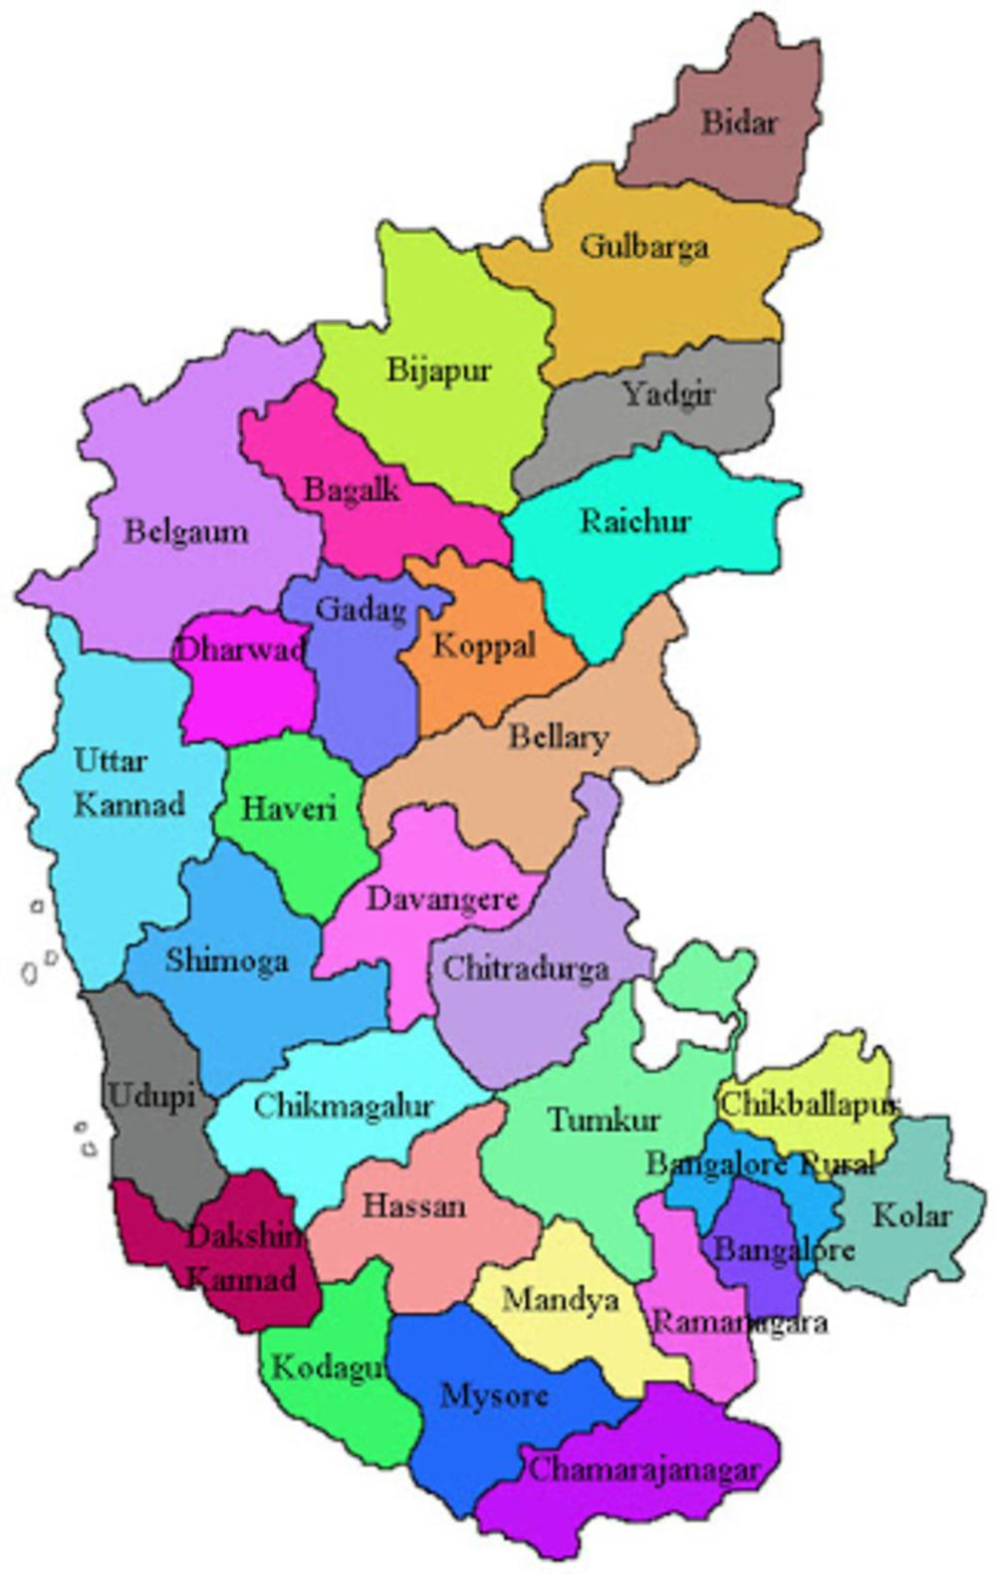

Silicon valley of India
Tech capital of India
ಸಿರಿ ಕನ್ನಡ
Wish you happy & safe stay
www.nirdhaarit.com

